Slide 1

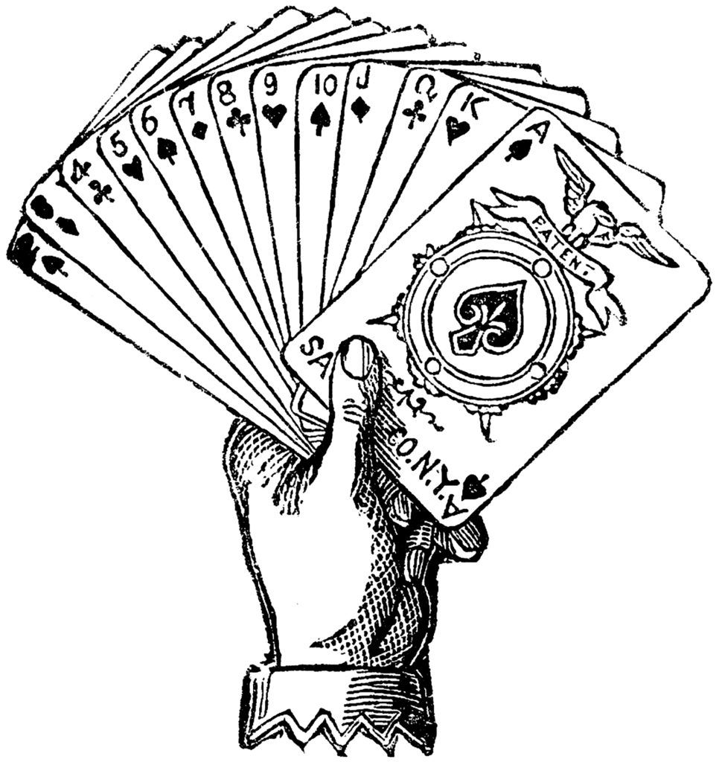
KHELGURUS
RUMMY
Presented By: SUDHARSHAN. V sudharshanvenkatesh123@gmail.com

Slide 2
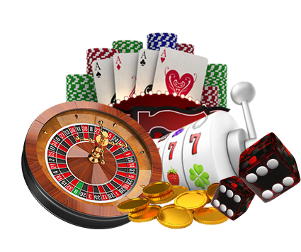



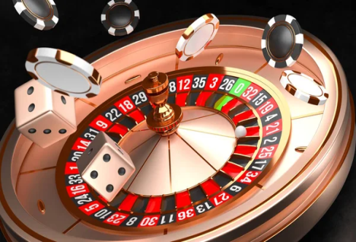
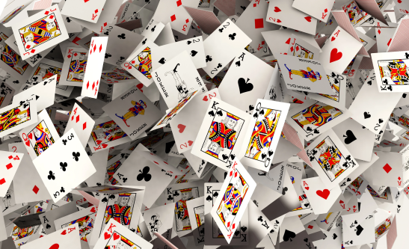
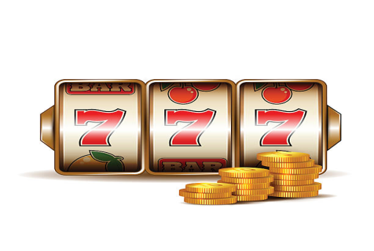
Key Considerations for Revitalizing Khelgurus
Acknowledge that the current negative perception of rummy must be changed.
Plan to introduce new features and creative advertising strategies to attract players.
Keep in mind that the implemented features and advertising strategies are based on a single day of research and may change in the future.
Recognize that marketing the current game features alone may not be effective in attracting players.
Strive to add new and innovative features to the game to increase player engagement.

Slide 3
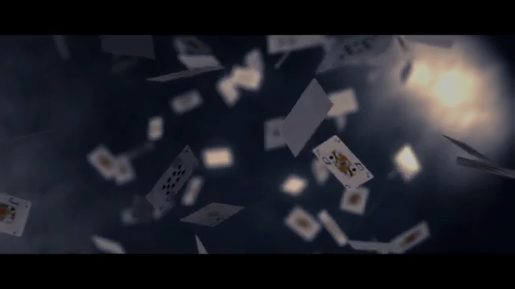

Slide 4
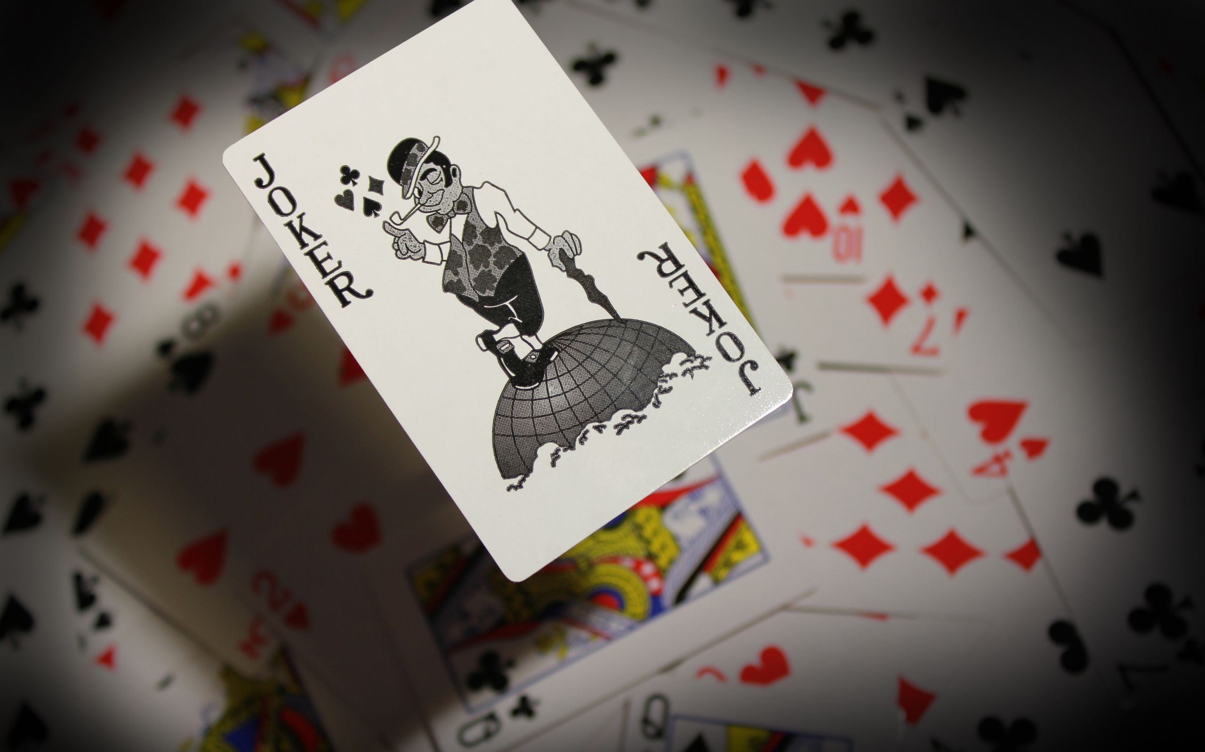
GOALS
1. IMPLEMENTATION OF NEW FEATURES.
2. MARKETING STRATEGIES.

Slide 5

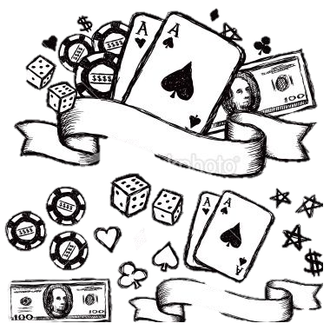
1.1.IMPLEMENTATION OF NEW FEATURES
There are a lot of rummy games out there, therefore if we make one, it should be unique from others. If users must install our game, we should attract them by providing new features like:
New Features:
1. Contest games (Tournament):
Roulette.
Casino.
Guess the cards
2. Rewards.
NOTE: Above implemented games are just an example. Any game can be implemented afterwards.

Slide 6


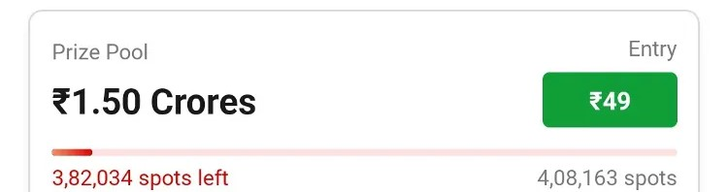

1.2.CONTEST
The place where we may draw users is through contests, which are similar to tournaments. Different competitions can be added, such as:
Legendary Contest.
Mega Contest.
Trending Contest etc..
We will host contests that require an entry fee, ranging from 15 to 50 rupees.
The number of available spots in each contest can range from 10,000 to over 15 lakhs, regardless of the number of players.
Users expect to invest less and win more, so we will offer attractive prize pools.
Instead of setting prize pools in lakhs or crores, we will calculate the prize pool based on the number of filled spots.
Details on price calculation and user interface will be provided in slide 1.7.

Slide 7

1.3.ROULETTE
This is the 1st game in the Contest.
GROUPS - There will be five groups = five rounds in this game. For each group, 500 coins will be distributed to each player.
COINS-SPLIT | GROUPS | T-COINS | USR BET PLACED | PLYR-C | COM-C | POINTS
50*2 | G-1 | 500 | 200,50, 100,100 | Even,B, 36,19-36 | Even,B, 36,19-36 | 450
100*2 | G-2 | 500 | 100,200 | 1-18, Split-7-8 | 12 | 100
200*1 | G-3 | 500 | 100,50, 200 | 1-8,E,12 | 14 | 150
- | G-4 | 500 | 50,100,200 | R-23, Odd | B-36,E | 0
- | G-5 | 500 | 50,100,200 | 19-36, Odd, 36 | 14,E | 0
TOTAL |  |  |  |  |  | 700

Slide 8
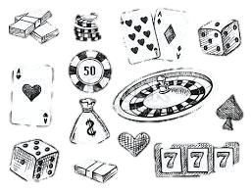
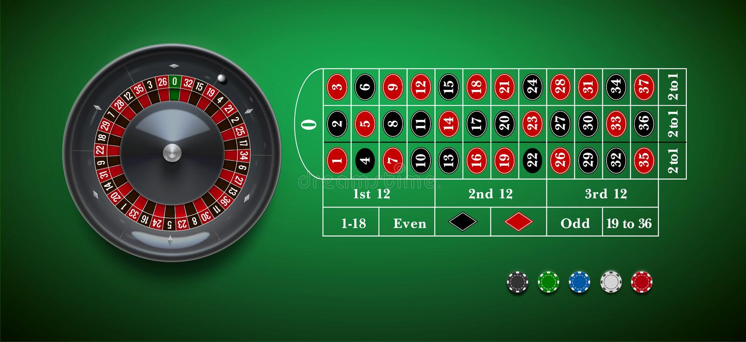
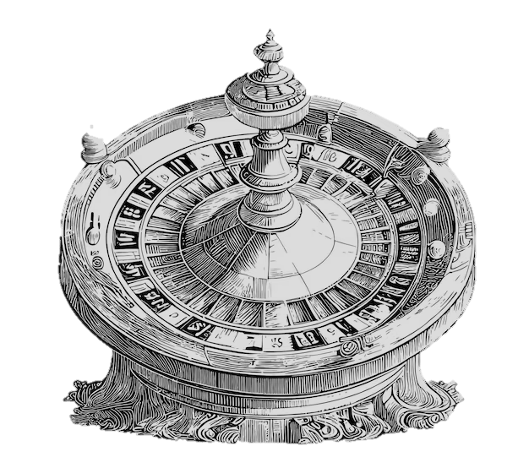
COINS - The total number of coins in each group is: two-50s, two-100s, and one -200 coin.
PLAYER CHOICE - On the roulette table, the player can place a bet.
Before the competition begins in 15 minutes, any player may alter their stake.
COMPUTER CHOICE - The computer begins playing the game automatically as soon as the contest starts.
POINTS - If the player makes the correct guess according to the bet place the points will be calculated.
For better understanding - https://youtu.be/6nKBlWaRI8w

Slide 9
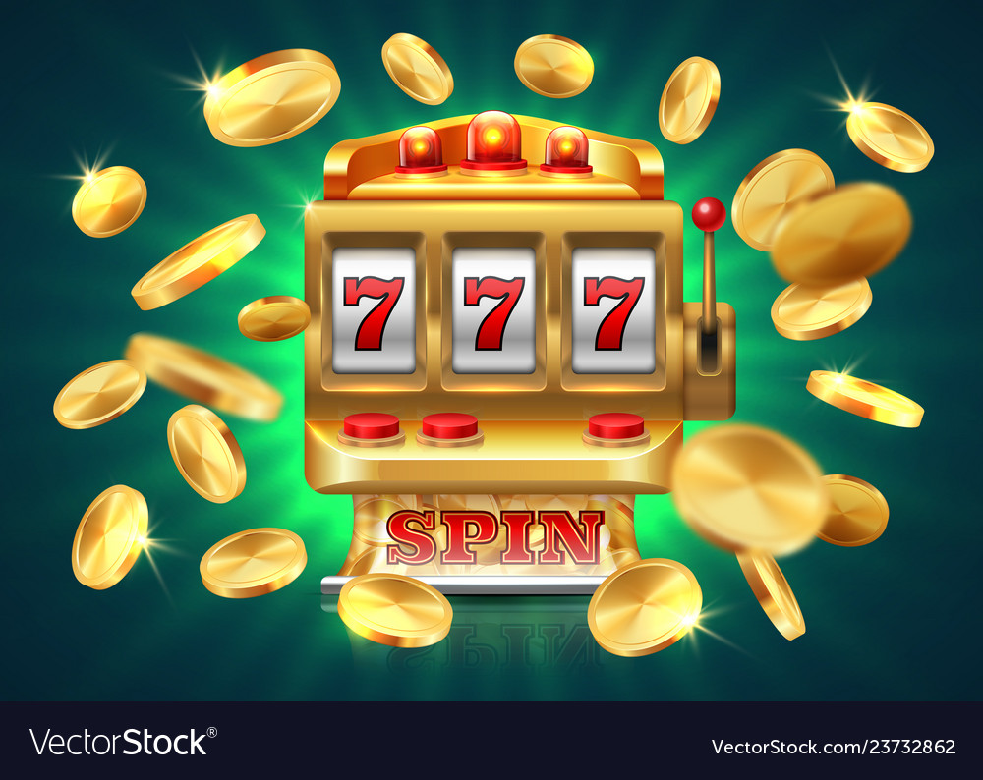
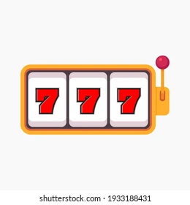

1.4.CASINO SLOTS
2nd game of the contest
GROUPS | PLYR-C | COM-C | POINTS
G-1 | 777 | 777 | J.P-100
G-2 | 871 | 832 | 8
G-3 | 789 | 249 | 9
G-4 | 237 | 237 | 12
G-5 | 777 | 787 | 14
Total 143
GROUP – There will be five groups = five rounds, in this game
Each group will have one slot available.
PLAYER CHOICE - Each group will only have one slot. The player should choose the numbers in each row from 1 to 9.
POINTS - It will be calculated as follows: in Group 1, if a player receives 727, the remaining numbers will be added with each row. If player gets 777 then is considered as jackpot, for jackpot the points is 100.
COMPUTER CHOICE - The computer begins playing the game automatically as soon as the contest starts.

Slide 10
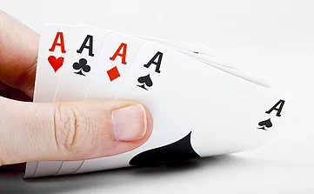
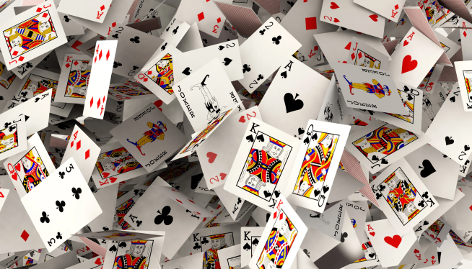
1.5.GUESS THE CARD
3rd game of the contest.
GROUP | CARDS | PLYR-C | COM-C | POINTS
G-1 | K-10 | K,Q,1 | K,Q,1 | 150
G-2 | K-10 | A,2,10 | A,3,9 | 50
G-3 | K-10 | J,A,8 | J,A,9 | 100
G-4 | K-10 | K,A,Z | Q,J,3 | 0
G-5 | K-10 | K,Q,J | K,2,1 | 50
TOTAL |  |  |  | 350
GROUP – There will be five groups = five rounds. Each group will have rummy cards from K to 10.
PLAYER CHOICE - Each group of 3 cards, from K to 10, can be chosen by the player or predicted.
COMPUTER CHOICE- Three cards are given out randomly by the computer as the game begins and is automatically completed.
POINTS - There are 50 points on each card.

Slide 11
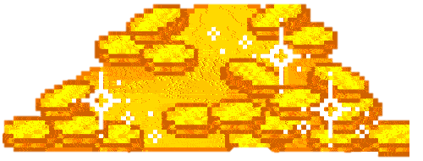



1.6.REWARDS
Rewards tab should be implemented on home screen.
Players must acquire reward coins, also known as super coins.
The player can purchase any rewards using these super coins, such as:
500 super coins for - T-Shirt.
1000 super coins for- Ear buds.
1500 super coins for- Smart Watch.
3000 super coins for -1500rs Amazon gift voucher.
Super coins can be earned in following ways:
Invite two friends - +50 Super coins.
Play first contest - +50 Super coins.
Amount added to wallet - +60 Super coins.
Contest joined - +5 Super coins etc…
if a player participates in any match or contest either wins or loses. He will receive +5 Super coins each time.
There are numerous other ways to gain super coins; the approaches listed above are merely suggestions.

Slide 12
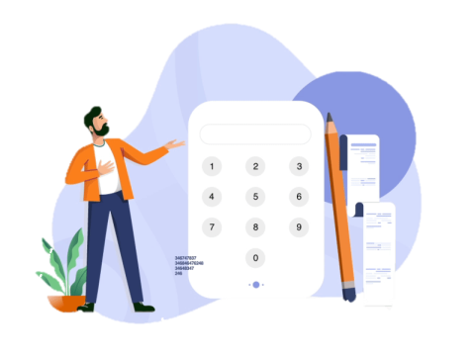
1.7.ABOUT CONTEST
Price Pool:
For Example: If the entry fee is 49 and there are 2 lakh spots available, the prize pool (amount won) is determined by the number of spots filled. Rs49 * 20000 equals Rs9,80,000 if only 20000 spots are filled.
We can set the price pool amount to – Rs6,50,331.
Profit: Rs3,29,669 = [Rs9,80,000 – Rs6,50,331]
The calculation below shows how price pool money can be awarded to winners.
PricePool Amount: Rs6,50,331
RANKS | PRICE AMOUNT | Nos OF PLAYERs | 650331 – TOTAL
1 | 90000 | 1 | 90000
2 | 60000 | 2 | 60000
3 | 30000 | 3 | 30000
4 | 9000 | 4 | 9000
5 - 20 | 3000 | 15 | 45000
21 -50 | 1000 | 29 | 29000
51 - 100 | 500 | 49 | 24500
101 - 170 | 300 | 69 | 20700
171 -300 | 100 | 129 | 12900
301 - 7020 | 49 | 6719 | 329,231
TOTAL |  |  | 0

Slide 13
1.8.OVERVIEW
A player can enter the contest by paying an entry fee ranging from 15 to 50 rupees.
The prize pool for the contest will be based on the number of filled spots and can range from 10,000 to above 15 lakhs.
Winners of the contest will receive a portion of the prize pool, with the amount varying based on their rank and the number of participants.
Both winners and losers of the contest will receive +5 Super coins.
The contest consists of three games where players must predict numbers or place bets.

Slide 14
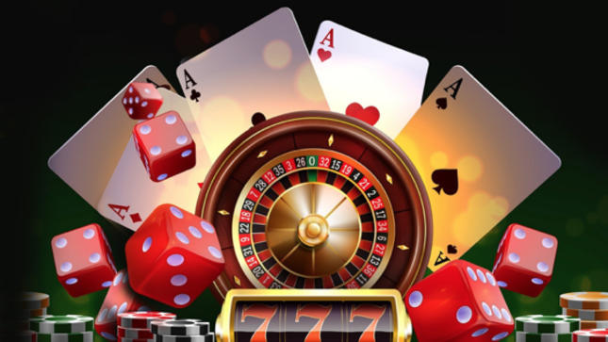

OVERVIEW
Contest duration: 30-45 minutes with a 15-minute review period to determine scores and rankings.
Two buttons available: Preview and Watch.
Preview button: - Before the contest starts: allows players to check prediction scores in each game.
After the contest starts: displays all three game groups and the score as the computer plays.
Watch button: available once the contest starts, allows players to watch the ongoing match played by the computer.

Slide 15


Slide 16

MARKETING STRATEGY

Slide 17

2.1.MARKETING STRATEGY
Release the game on the Play Store before marketing it to gain trust from potential players.
Avoid distributing the apk file through the website as it may be perceived as untrustworthy.
Create creative advertisements to promote the game on social media instead of paying celebrities.
Hire the finest editor to create ads that describe the game and its name.
The initial ad should focus on introducing the new
rummy game in the market and its potential winnings,
without going into detail about how it

Slide 18

SOCIAL
MEDIA

Slide 19

2.2.SOCIAL
MEDIA
Once the creative advertisement is complete, we can spread the word about the product on social media like:
Instagram.
Facebook.
Twitter.
YouTube etc..
A person should watch the advertisement on a social media at least 8–10 times a week. As a result of seeing that, people will give a try.
It is not by advertising on social media we attract more people. The key concern is how we portray our game through advertising and filmmaking after it has promoted in social media. (will be explained in next slide 2.3)

Slide 20


2.3.ADVERTISEMENT
Instead of solely highlighting the prize amount, we will promote the reality that playing our game allows players to spend time with family without getting addicted.
New and innovative features will be added regularly to keep the game fresh and exciting.
These strategies will aim to attract players from other rummy games and showcase our game as a new and better option in the market. These ideas are subject to change and will be refined during the brainstorming process.
Creative advertising strategies will be developed, focusing on the unique aspects of our game compared to other rummy games.
We will implement contests as a way to encourage healthy competition and engagement among players.
https://youtu.be/DO-rtSPgXMY https://youtu.be/ag2yEzKJk3c
Note - These are my personal opinions, and this advertisement could be explained further over a phone call.

Slide 21
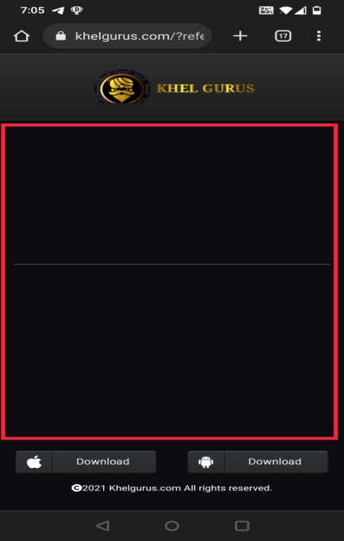
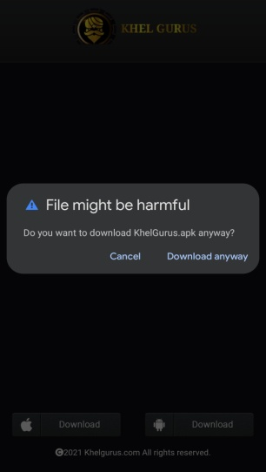
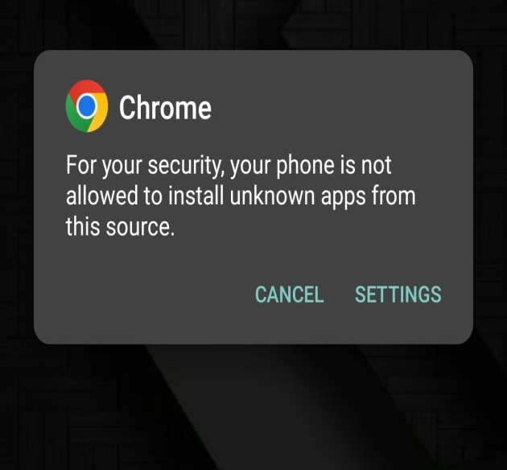
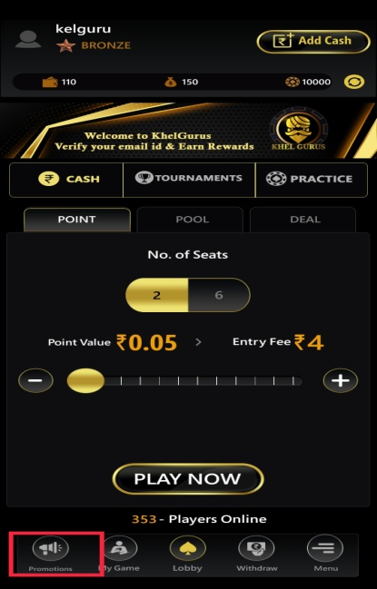

ISSUES FOUND IN KHELGURUS
ISSUE - By taping on promotion button White screen with no promotion is displayed.
ISSUE - While downloading the game. The warning "File might be harmful" displayed. Which leads Users not to trust.
ISSUE – There is no content in download screen.
SOLUTION - Any of our contest or tournament advertisements could be added to the download page.
SOLUTION - If there is no promotion, "Coming Soon" text should appear when tapped.
SOLUTION - The game must be made available on the Play store. to gain the trust of users.

Slide 22


